Slide 1
CASE STUDY - HR ANALYTICS Exploratory & Predictive Analytics
Presented By: Mriganka Paul
Roll No. A21019
BDSN Project

Slide 2
Overview
Description of the problem
Why it is important to solve the problem
Benefits from Predictive Modeling in HR
Data Description
Exploratory Data Analysis
Data Preparation and Pre-processing
Model
Logistic Regression
Summary of Results
Model Usefulness

Slide 3
Description of the problem
Human Resources are critical resources of any organization. Organizations spend huge amount of time and money to hire and nurture their employees. It is a huge loss for companies if employees leave, especially the key resources. So if HR can predict whether employees are at risk for leaving the company, it will allow them to identify the attrition risks and help understand and provide necessary support to retain those employees or do preventive hiring to minimize the impact to the organization.

Slide 4
Why it is important to solve the problem
Predictive retention modeling allows organizations to identify high-risk employees, build profiles of those most likely to leave or stay, and understand how risk is distributed throughout the organization. Several innovative large organizations have started building these kind of HR analytics with great success in the past years (e.g. Google, HP,…). Next to the traditional HRIS dashboard with descriptive turnover information, we see more and more companies adding these predictive turnover information to their standard reporting.

Slide 5
Benefits from Predictive Modeling in HR
Recognize the strengths and vulnerabilities of the workforce and predict vacancies and leadership needs.
Track and analyze critical skills, and predict which skills will be lost and when by predicting turnover.
Measure turnover, understand its causes and design programs to control it to reduce vacancy costs – both financial and productivity – to avoid their devastating effects on business performance.
Understand and mitigate risk linked to seasonal absences, resignation trends or length of employment to prevent being blindsided by loss of critical workers, skills or leadership.
Measure, monitor and predict the effect of risk factors over time and prevent organizational risk by devising contingency plans based on insight and foresight.

Slide 6
Data Description
satisfaction_level: Employee satisfaction level
last_evaluation: Last evaluation
number_project: Number of projects
average_montly_hours: Average monthly hours
time_spend_company: Time spent at the company
Work_accident: Whether they have had a work accident
promotion_last_5years: Whether they have had a promotion in the last 5 years
department: Department
salary: Salary
left: Whether the employee has left

Slide 7
Exploratory Data Analysis
Checked the schema of the data and below are the observations-
Features which are numeric-
satisfaction_level
last_evaluation
number_project
average_montly_hours
time_spend_company
Work_accident
left
promotion_last_5years
Features which are string-
Department
Salary
There are no null/missing values in any of the features.
There are 14999 records and 10 features in the dataset.

Slide 8
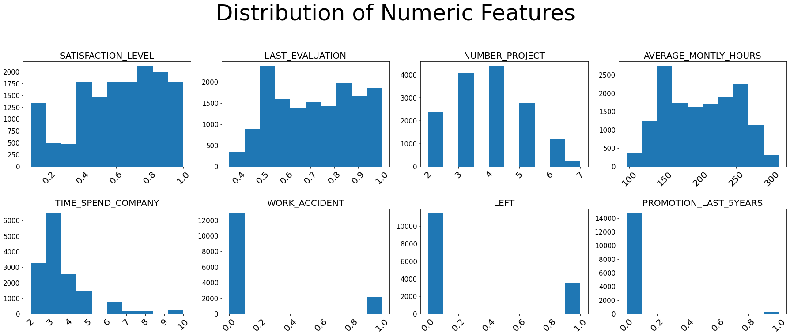
Exploratory Data Analysis
From the distribution we see that the features “Work_accident” , “left” and “promotion_last_5years” are binomial, i.e. “0” means “No” and “1” means “Yes”

Slide 9
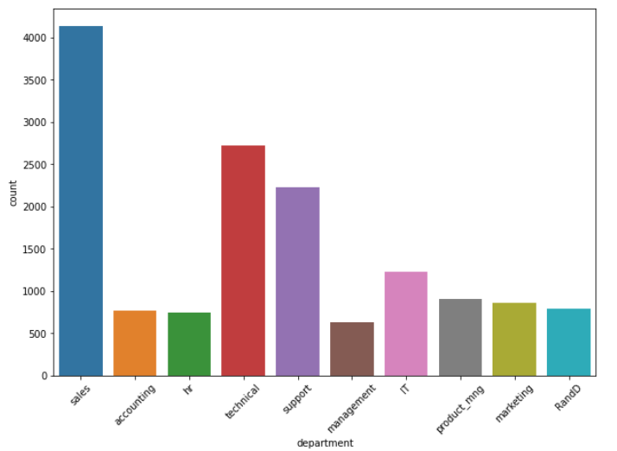
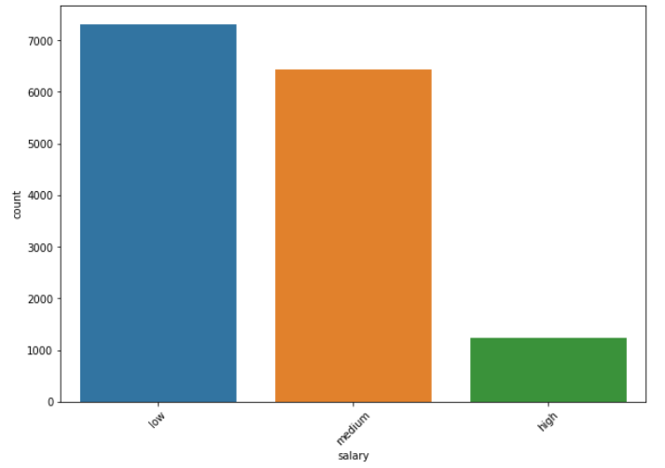
Exploratory Data Analysis
The above graph shows the number of employees on each department. “Sales” department has the highest number of employees and “Management” department has the lowest employees.
The above graph shows the number of employees each of the salary bands. Number of employees under “low” salary band is the highest followed by “high” at the lowest.

Slide 10
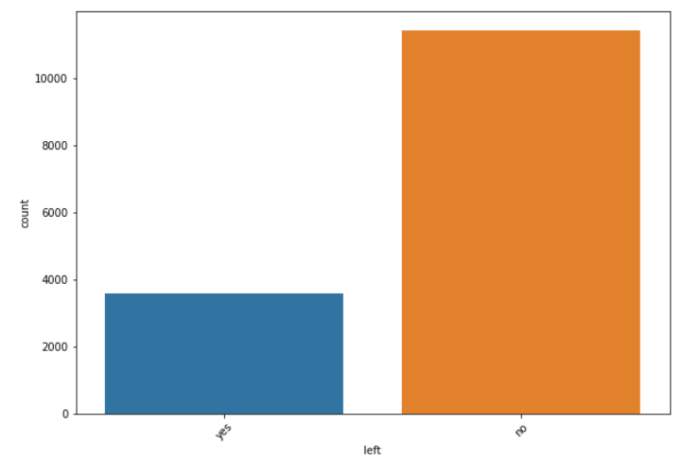
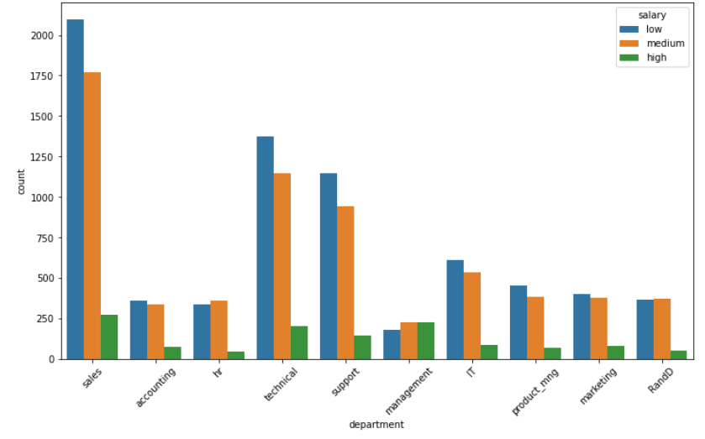
Exploratory Data Analysis
The above graph shows the number of employees who left or did not leave the organisation. About 31% of the employees have left the organisation.
The above graph shows the number of employees each of the salary bands in each of the departments. In each of the departments employees getting high salary are the lowest except “Management” department where it totally the opposite.

Slide 11
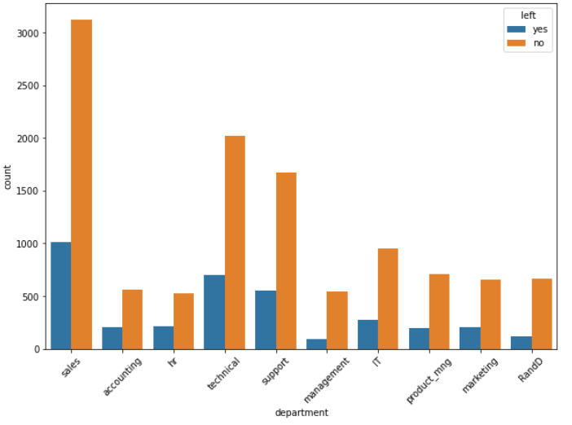
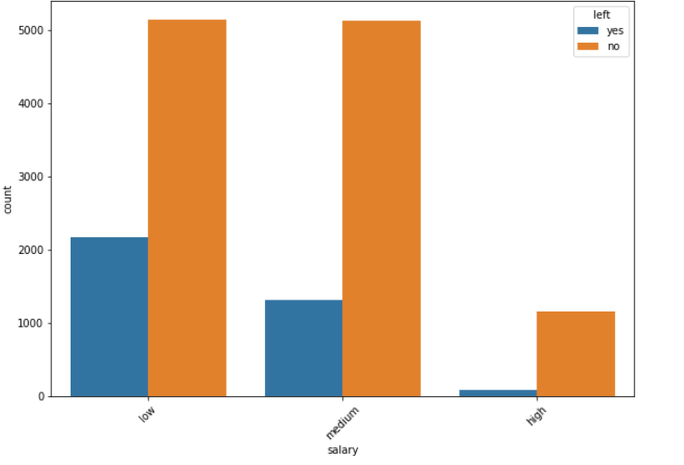
Exploratory Data Analysis
The above graph shows the number of employees who left or did not leave the organisation from each of the department.
The above graph shows the number of employees each of the salary bands and the employees who left the organisation from each of these band

Slide 12
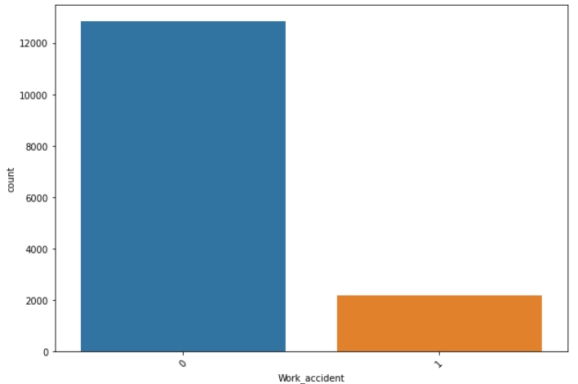
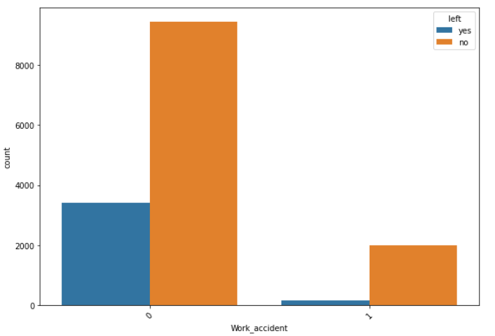
Exploratory Data Analysis
The above graph shows the number of employees who suffered accident during work
From the above graph we can understand how many of the employees suffered accident during work left the organisation.

Slide 13
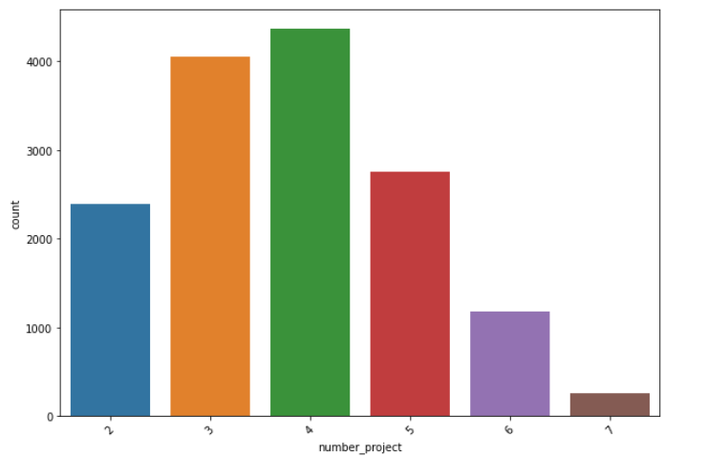
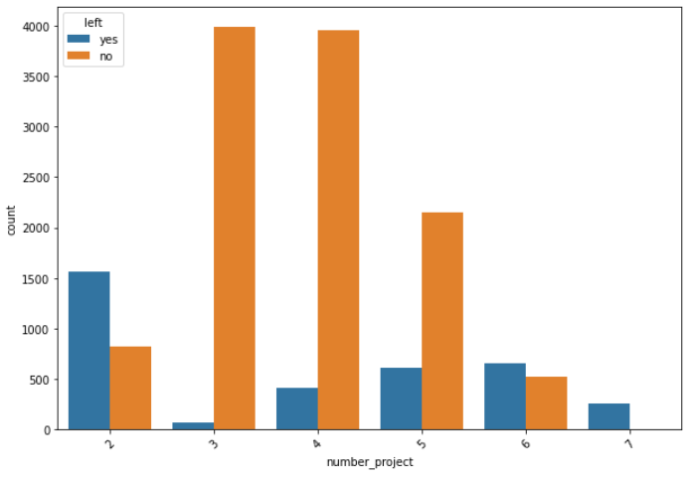
Exploratory Data Analysis
The above graph shows the number of employees who were working on 2 to 7 projects
From the above graph we can understand how many employees left the organisation and were working on how many projects.

Slide 14
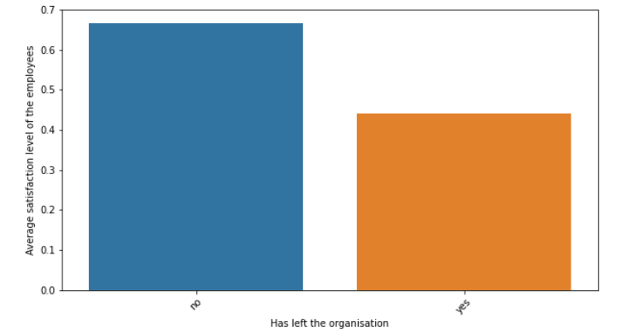
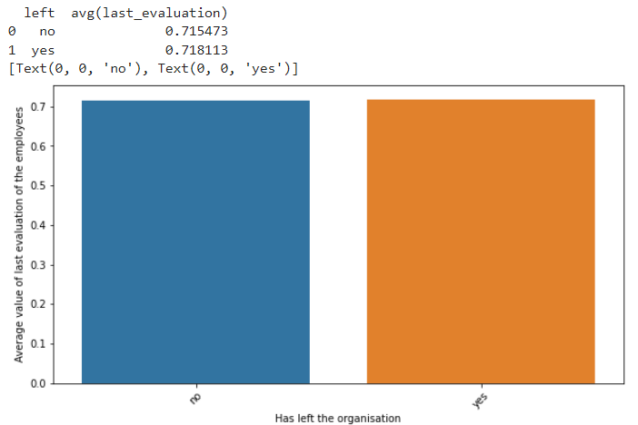
Exploratory Data Analysis
This graph shows the mean satisfaction level between the employees who left and the ones who are still working in the organisation.
This graph shows the average rating between the employees who left and the ones who are still working in the organisation.

Slide 15
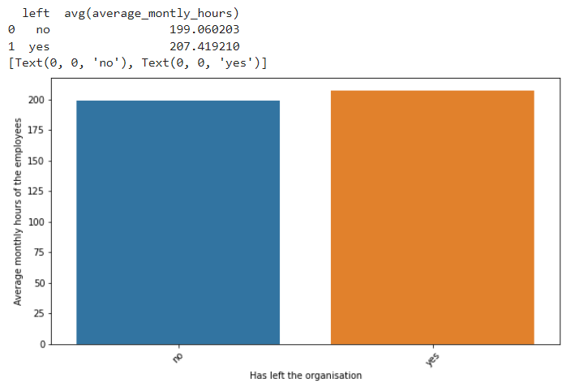
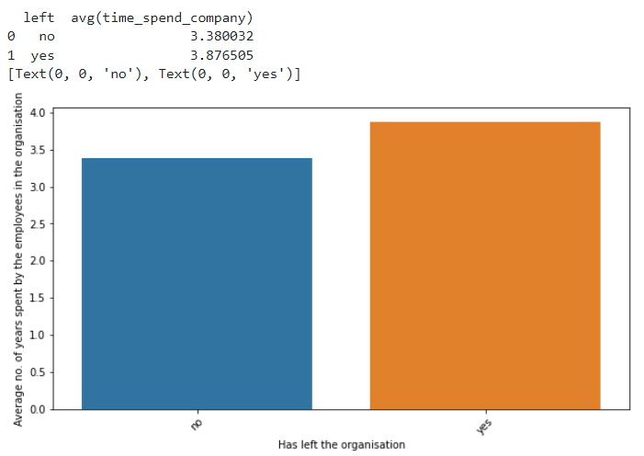
Exploratory Data Analysis
This graph shows the average monthly hours of working between the employees who left and the ones who are still working in the organisation.
This graph shows the average number of years working with the organisation between the employees who left and the ones who are still working in the organisation.

Slide 16
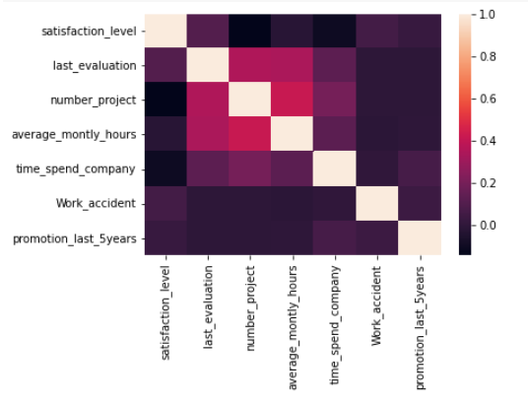
Exploratory Data Analysis
This shows the correlation among the numeric features.
We can see that there are not much strong correlation between the features.

Slide 17
Data Preparation and Pre-processing
Did one-hot encoding for the features which are string data types.
Since the categorical features in the dataset are string values, it become necessary to use String Indexer first to convert the string values into label indices (numeric values) and then use the one-hot encoding.
Defined the features using vector assembler.
Defined the target variable.
For our Logistic model we have taken “left” as the dependent variable and other features as independent variable.
Then using the StandardScaler scaled all the features to bring them to same range.
Splited the data into train and test data using Random split where train set had 70% of records and for test we had 30% of the records.

Slide 18
Model
Logistic Regression is a popular method to predict a categorical or binary response.
The main intention behind using this learning algorithm is to handle the class imbalance. Logistic Regression is one of the implementation of linear models, for which spark provides ability to handle the class imbalance by adding a class weights.
We developed Logistic Regression Classifier model to predict whether the employee will stay in the organisation or leave it.
We used pyspark.ml.classifier package to implement the model with optimized hyper parameter.

Slide 19
Summary of results
The accuracy percentage was about 81%.
We also verified the other metrics like
Precision %
Recall %
F1 score %
Tools used in the project –
Python
Pyspark
Matplotlib and sns

Slide 20
Model usefulness
Our model can be useful to provide comprehensive analysis of the historical data and a smart prediction about the employees attrition to help the organisation better understand its employees.
We would really hope that using our model will help the organisation to reduce the number of employees leaving and will also be helpful to make the organisation the “The Best Organisation to work with”

Slide 21


